Slide 1
Google Developers Students Club-IBA
BOOTCAMP - REACT NATIVE

Slide 2
Thanks for joining we will start at 🕒

Slide 3


OUR AGENDA
What is React native
Advantages of React native
Why React Native
Pre-requisites and workspace of react native

Slide 4


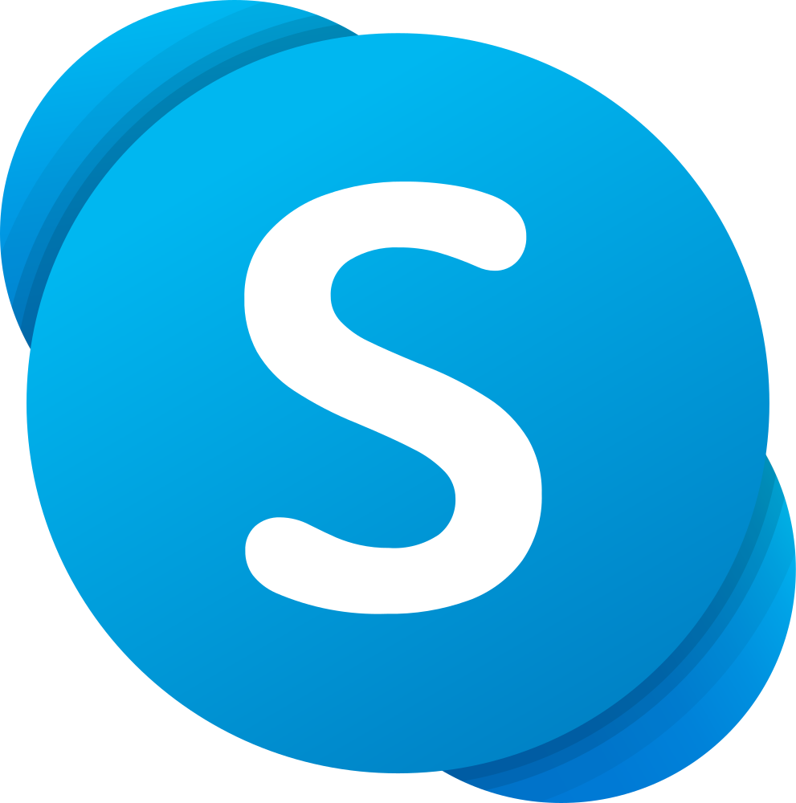



THE COMPANIES THAT USE REACT NATIVE
Instagram
Facebook
Skype
Discord
Tesla
Adidas
THERE ARE ALOT OF COMPANIES THAT USE REACT NATIVE FOR BUILDING THEIR MOBILE APPS. FEW INCLUDE 👉

Slide 5
What is React Native
Open-source JavaScript Framework for building mobile apps using the React library.
Build cross platform apps (Android/iOS).
React Native apps are not hybrid apps.
Do not run in a WebView.

Slide 6
Advantages of React Native
Open Source
Much less expensive
Easier to Code
Save massive amounts of Time

Slide 7
Why React Native
Cross-Platform
JavaScript
Performance
Large Developers’ Community
It Keeps Getting Better
Used by Many Companies
Excellent Career Opportunities

Slide 8
PreRequisites and WorkSpace
of React Native
JavaScript ES6
HTML
CSS
Node – version >=4
Watchman (if using React Native CLI)
Xcode (to run iOS simulator)
Android Studio (To run on Android Emulator)
Android AVD

Slide 9
👈
React Native
v/s
Flutter
👉
Created by Facebook
Uses JavaScript
Large Community (found in 2015)
Quite Mature ( Already has a lot of pre-written codes)
Created by Google
Uses Dart Language
Growing Community (found in 2018)
Not as Mature (no many pre-written codes)

Slide 10
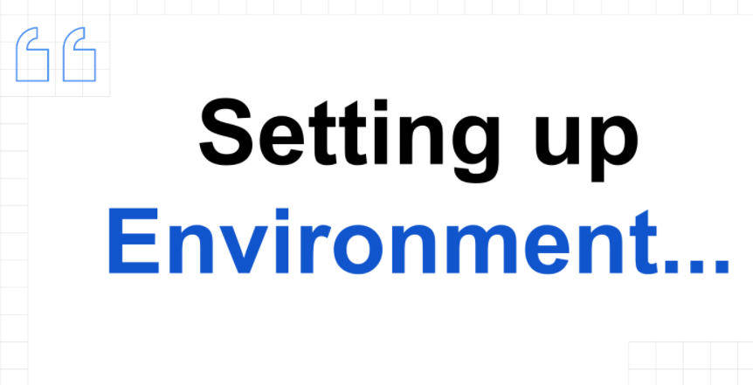

Slide 11
